Slide 1
Cardiovascular disease prediction by using machine learning
Presented by:
Supraja.Gorantla(700740906)

Slide 2
Contents:
Motivation
Objectives
Related work
Problem Statement
Proposed Solution
Results/Simulations
References
Conclusion

Slide 3
Motivation:
Cardiovascular disease is most common disease that is getting attention from the researchers. The study of disease forecasting has become an inevitable process in future healthcare development.
With the help of tremendous medical data and increased computational capabilities, machine learning has proved one of the most efficient prediction methods in cardiovascular disease forecasting

Slide 4
Objectives:
The main objective is to determine the cardiovascular risks at the early stage.
Usage of enormous data collected from the medical records and health surveys
Using the computational power and machine learning algorithms to predict the accurate results.
Use of an intersection field of computer science and statistics that aims to develop algorithms to find patterns and relationships between the historical data and identify the disease cases.

Slide 5
Related work:
Dataset description
Operating environment
Nearest Neighbors
Decision Tree
Random Forest
Gradient Boosting
Reinforcement learning

Slide 6
Problem Statement:
●There are different classification models that classify or predict heart diseases by using clinical data, but selecting the best model that suits the problem is a challenge
●Usually, diagnostics data come in high dimensions, which is a challenging task to process

Slide 7
Here the process involves:
Training the data
Feature selectio
Building model
Performance evaluation.

Slide 8
Proposed solution:
The data is collected from the UCI machine learning repository.
The data is passed through the dimensionality reduction methods to reduce the data to lower dimensions.
Machine learning techniques such as confusion matrix and naive bayes theorem are applied on the reduced data and heat map functions to create the confusion matrix
Here these algorithms provide the accuracy of 83% when compared to the other models.

Slide 9
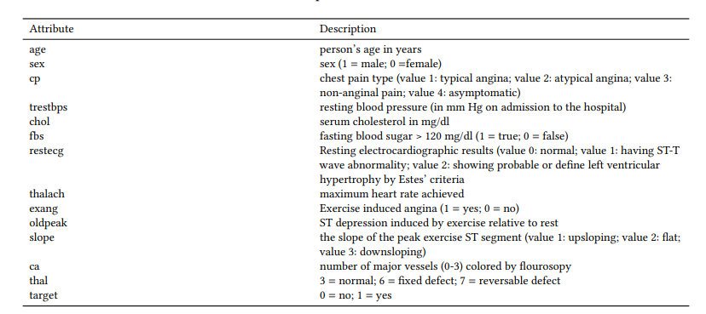

Slide 10
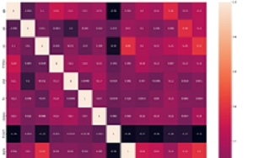
Results & simulations
Here are the confusion matrix that generated for the 14 attribute values used in the dataset to predict the accuracy of getting the heart diseases.

Slide 11
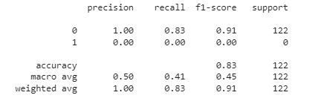
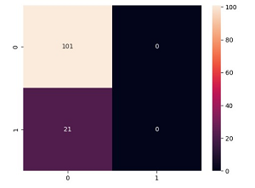
Results:

Slide 12
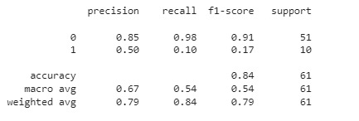
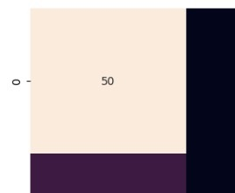
Naive bayes model:

Slide 13
References:
[1] N.J. Wald. 2003. A strategy to reduce cardiovasscular disease by more than 80%. BMJ 326, 7404 (2003), 1419. DOI:http://dx.doi.org/10.1136/bmj.326.7404.1419
[2] Keaven M. Anderson, Patricia M. Odell, Peter W.F. Wilson, and William B. Kannel. 1991. Cardiovascular disease risk profiles. American Heart Journal 121, 1 (1991), 293–298. DOI:http://dx.doi.org/10.1016/0002-8703(91)90861-b
[3] Thomas G. Dietterich. 1990. Editorial Exploratory Research in machine learning. Machine Learning 5, 1 (1990), 5–9. DOI:http://dx.doi.org/10.1007/bf00115892
[4] M.I. Jordan and T.M. Mitchell. 2015. Machine learning: Trends, Perspectives, and prospects. Science 349, 6245 (2015), 255–260. DOI:http://dx.doi.org/10.1126/ science.aaa8415

Slide 14
Conclusion:
By using all the eight models by four machine learning algorithms with different criteria,the result shows the random forest constructed by the CART algorithm has the best performance among eight models, which achieved an accuracy score of 87% when compared to the other models.
As gradient boosting models emphasize that produce inconsistent results that cannot justify all the data points when used a small data set.

Slide 15


